Slide 1
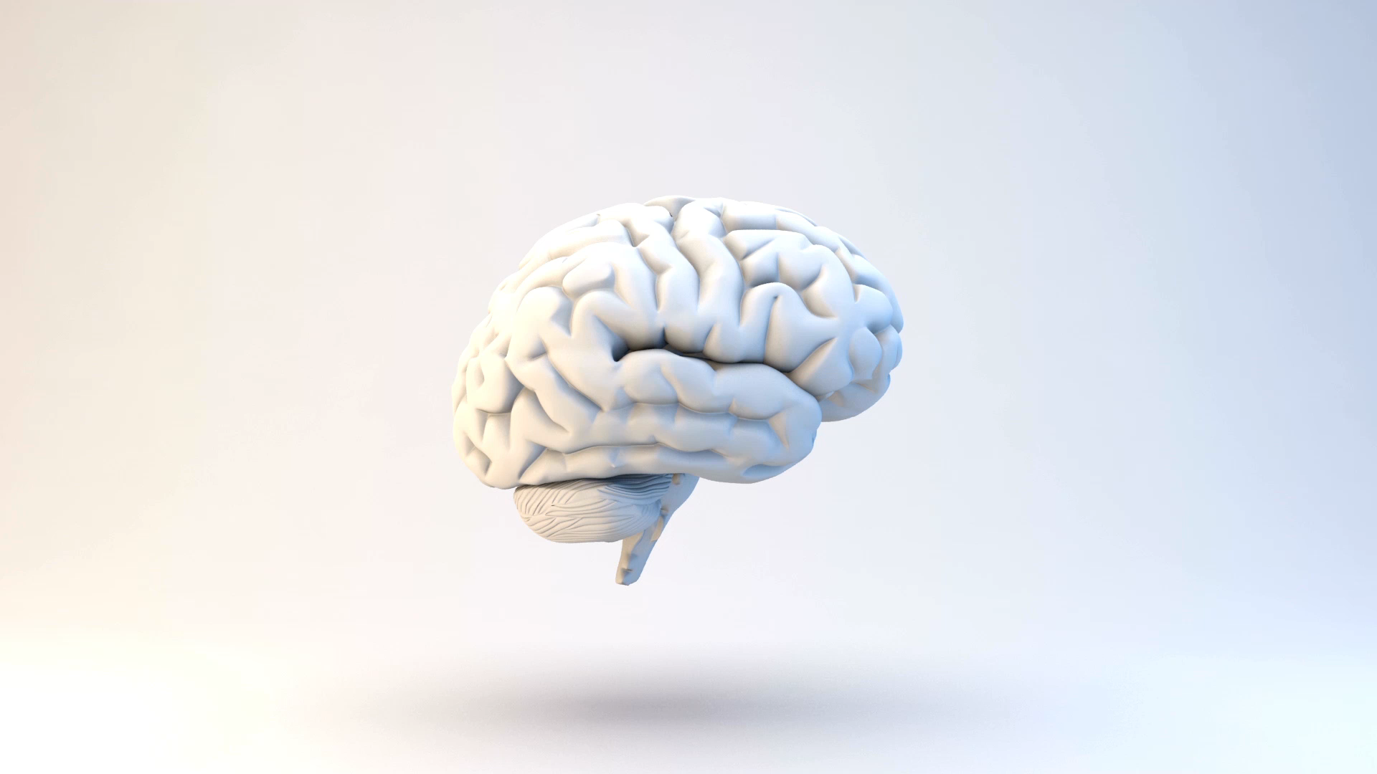
VVT en de kansen van AI
Project Proposal

Slide 2
Context & Goal
Increased need for elderly healthcare
Staff shortage
Introduction of AI
ECD
Anonymise/ psudonomilisation data
Data transfer between datasource and AI
Notes:
This is accompanied by a growing staff shortage, rising healthcare costs, and more complex treatments. For a sustainable future, structural solutions are being sought,
including the use of artificial intelligence (AI) and interactive technologies.
Currently, it is difficult to figure out when a patient may fall. Caregivers have a measuring moment with the patients in the nursing homes. This data is recorded in an ECD, and that's it.

Slide 3
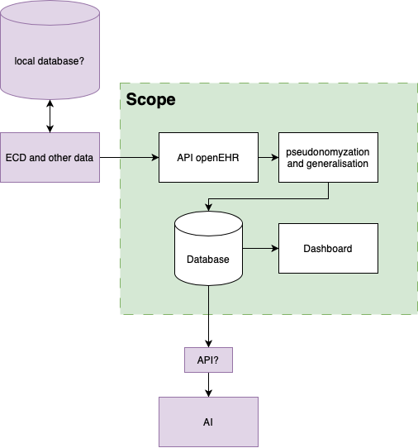
Scope
Inside scope: Green
Outside scope: Purple

Slide 4
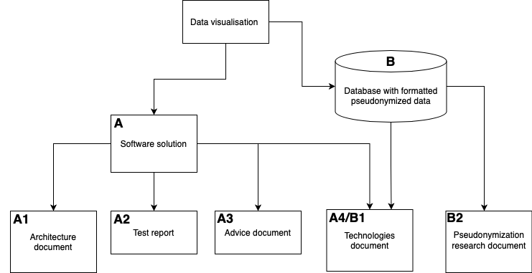
Deliverables
Reading guide
Solutions
Documents

